Slide 1

Global Mental Health in a Christian Context

Slide 2
Seven Principles of Mental Health in a Christian Context
Dr. Samuel Pfeifer
Clinic Sonnenhalde / Switzerland
www.psy77.com

Slide 3
My Professional Background
1988-2013 Medical Director Christian Mental Health Service «Klinik Sonnenhalde» («Sunny Hill») in Riehen near Basel.
Inpatient Services: 68 Beds
Outpatient Services: 12’000 consultations per year
Day Treatment Center
Medical Studies in Zurich, studies in Psychology and Theology at Biola University (Rosemead School of Psychology) in Los Angeles, USA.

Slide 4
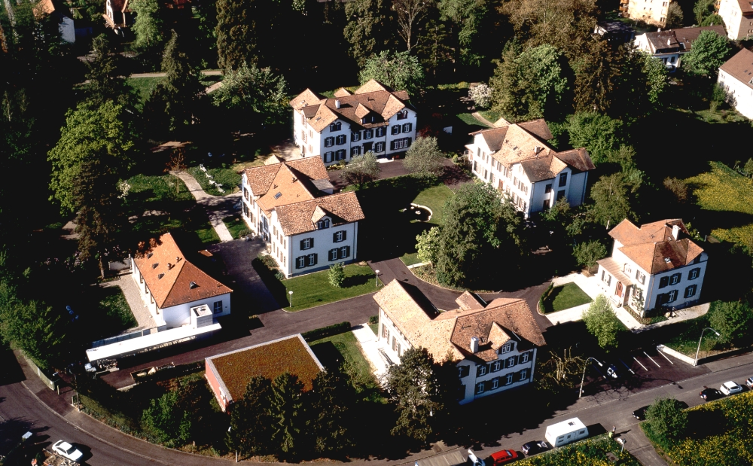
Clinic «Sonnenhalde» in Switzerland

Slide 5
Three pillars
Compassionate
Professional
Christian

Slide 6

Therapeutic Concept
Social
Therapy
Disorder-
specific
Therapy
Rehab
Work
Milieu-Therapy

Slide 7
The therapeutic network
State Clinics
Clinic
Policlinics
Day Care Clinic
GP
Psychiatrist
Outpatient Dept.
Counselors
Inpatient Services: 68 beds, 500 intakes per year
Day Care Clinic: 20 Patients
Outpatient Dept: >12‘000 Consultations p.y., 1400 patients
Sheltered Homes

Slide 8
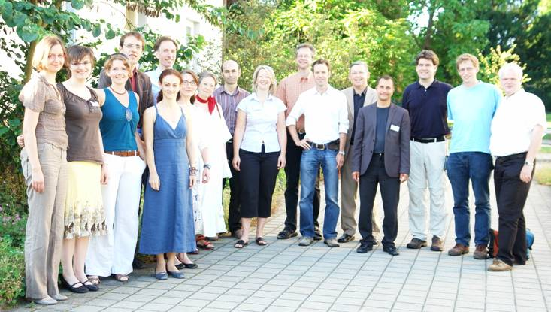
Bild Ärzte 2008!!
Our Team 2008

Slide 9
Overview: Seven Principles
Compassion
Professional
Admonishing / Exhorting / Correcting
Comfort / encouragement
Supporting the Weak
Patience
Hope

Slide 10
Chrstian Mental Health Care (CMHC) is COMPASSIONATE
1
The most basic attitude of Jesus was compassion:
Matthew 9,36: He was moved
  When he saw the crowds, he had compassion on them, because they were harassed and helpless, like sheep without a shepherd. (NIV)
  35-37 - Then Jesus made a circuit of all the towns and villages. He taught in their meeting places, reported kingdom news, and healed their diseased bodies, healed their bruised and hurt lives. When he looked out over the crowds, his heart broke. So confused and aimless they were, like sheep with no shepherd.“ (The Message)

Slide 11
CMHC has to be PROFESSIONAL
2
Although this is probably an emphasis of our time,
there are Biblical hints to this.
After having healed a group of lepers, Jesus ordered
them to consult the professionals of their time. (Luke 5:15; Luke 17:14)
Ethical guidelines --- professionalism along accepted guidelines (DSM-Diagnosis, APA Treatment Guidelines, Medications)
However, leaving out religious and culturally sensitive aspects, would be unprofessional as well.

Slide 12
Professional Issues
Medical interest, knowledge and continuing education.
Having a model of disease and healing.
Having a model of supportive treatment in chronic illness.
Integrating Psychiatry and Theology on an academic and professional level.
Boundaries: The problem of professional sexual misconduct; acknowledging your own limitations (“He grants peace to your borders” – Psalm 147,14).

Slide 13

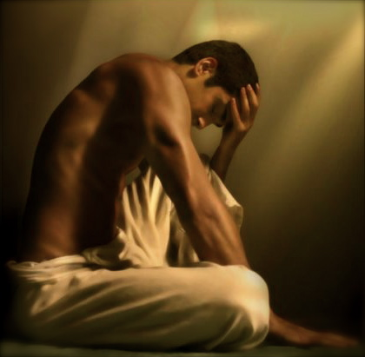
What are the causes of depression?
We have to give basic answers to the questions of our patients.
PSYCHO-EDUCATION

Slide 14
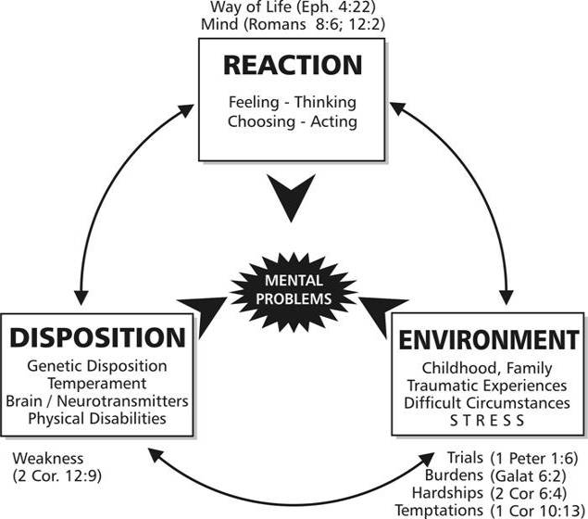
The Bio-Psycho-Social Model

Slide 15
Four Biblical Strategies
1. Thessalonians 5:14
1. Exhort
Idle, unruly
2. comfort, encourage
Anxious, timid
3. support, help
The weak
4. Be patient
everyone

Slide 16
Admonish, Exhort, Correct
3
Life Style influences health
Mental Health is influenced by wrong behavior patterns,
e.g. alcohol, violence, wrong thinking
We need programs to help people get away from substance abuse.
Marriage Encounter – Teaching foundations of a good relationship and family life
Teaching Biblical Values

Slide 17
Comfort, encourage, reassure
4
Good words are a balm for the soul
Encouraging a person can help to bring out the best in her and motivate her to go on despite the burdens of life
Whom? – The anxious, the depressed, the suffering, those who are mourning etc.
God is also a God of Comfort (2. Cor. 1)

Slide 18
Support the Weak
5
A biblical concept of WEAKNESS in relation to the Mental Health concept of VULNERABILITY, of psycho-social burden, of disability through chronic mental health disorders (DALY)
Who are the weak in mental health?
Those who cannot change despite their efforts and good desires

Slide 19
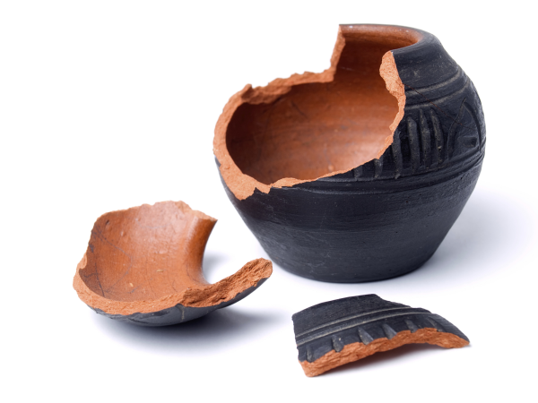
Support the Weak
5
Biblical emphasis of WEAKNESS
2. Corinthians 12:11
2. Corinthians 4:6-10
Isaiah 42:1-4: bruised reed, smoldering wick

Slide 20
PATIENCE
6
In our world of fast internet connections and instant solutions – mental problems take their time
We should be patient WITH ALL PEOPLE
Giving them time to change, to heal, to mature into the image of God
Colossians 1:11: «being strengthened with all power according to his glorious might so that you may have great endurance and patience.”

Slide 21
HOPE and MEANING in trouble
7
God is a God of Hope
Isaiah 43:1-4
Hope in mental health services
Spiritual aspects of hope and meaning (Victor Frankl)
False ways to find hope (superstition, over-reliance on medicine / other people)
The use of hopelessness – acceptance of weakness

Slide 22
Summary
To be a good people helper, these values will guide you.
Compassion
Professional
Admonishing / Exhorting / Correcting
Comfort / encouragement
Supporting the Weak
Patience
Hope

Slide 23
www.psy77.com
More Presentations on Global Mental Health in a Christian Context

